Slide 1
Hydrostatic Force & Center of Pressure on Submerged Plates
An interactive Streamlit calculator with an animated schematic
Lalluvadiya Jenil Sagarbhai
Enrollment No. 25012251210001
Diploma in Automation & Robotics Engineering
Lok Jagruti Kendra University

Slide 2

Problem overview
The problem
Pressure on a submerged plate grows with depth. Engineers need the total thrust and the point where it acts, but solving each numerical by hand is slow.
free surface
H
Scope
Rectangular or circular plate, vertical or inclined, in water, sea water, oil, mercury or a custom liquid.
C
Resultant F
CP
Output
Total thrust F, center of pressure depth h_cp, and a live schematic of centroid vs center of pressure.

Slide 3
Formulas used
Total thrust
Center of pressure
F = ρ · g · h̄ · A
h_cp = h̄ + I_G sin²θ / (A · h̄)
ρ density, g gravity, h̄ centroid depth, A area
θ is the angle of the plate with the free surface
Rectangular plate
Circular plate
A = b·h I_G = b·h³ / 12
A = πR² I_G = πR⁴ / 4
h̄ = H + (h / 2) sinθ, with H the depth of the top edge
h̄ = H, the depth of the centre of the circle

Slide 4
App features
ρ
Many fluids
θ
Any geometry
▶
Live animation
Water, sea water, oil, petrol, glycerin, mercury, or a custom density and colour.
Rectangular or circular plate, vertical or inclined at any angle.
The tank refills and pressure arrows redraw for every new input.
F
Instant results
!
Validation
↗
Graphs
Thrust, CP depth, area, I_G and horizontal and vertical components.
Clear errors for zero, negative or impossible values. No upper limit on inputs.
Pressure distribution and CP gap vs depth, with labelled axes and gridlines.

Slide 5
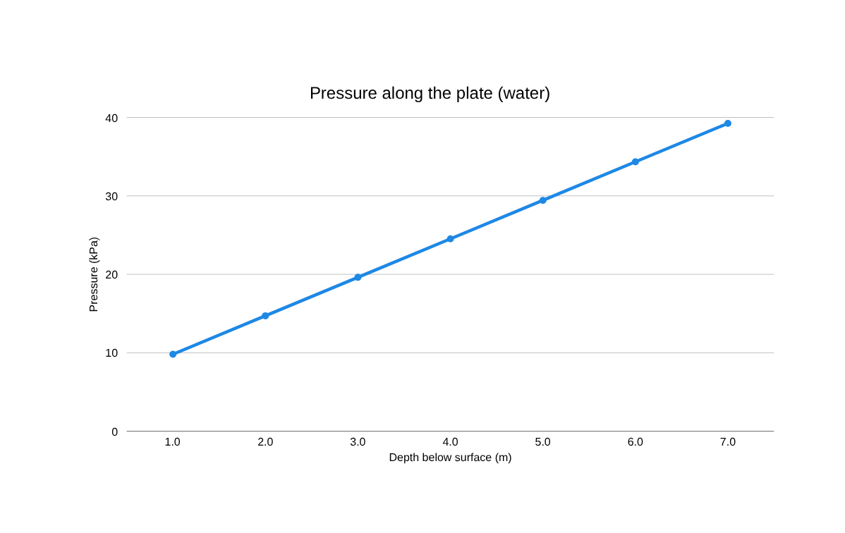
Manual vs app: worked example
Water, rectangular plate b = 2 m, h = 3 m, top edge H = 1 m, vertical (θ = 90°)
147.15 kN
Total thrust F
2.80 m
Center of pressure h_cp
0.30 m
CP below centroid (h̄ = 2.5 m)
By hand: F = 1000 × 9.81 × 2.5 × 6 = 147 150 N, and h_cp = 2.5 + 4.5 / (6 × 2.5) = 2.8 m. The app uses the same formulas and gives the same values (0 % error).

Slide 6
Now, let's look at the submarine example
and a demo of the app.

Slide 7


SUBMARINE
Hydrostatic force on a submarine hatch

Slide 8
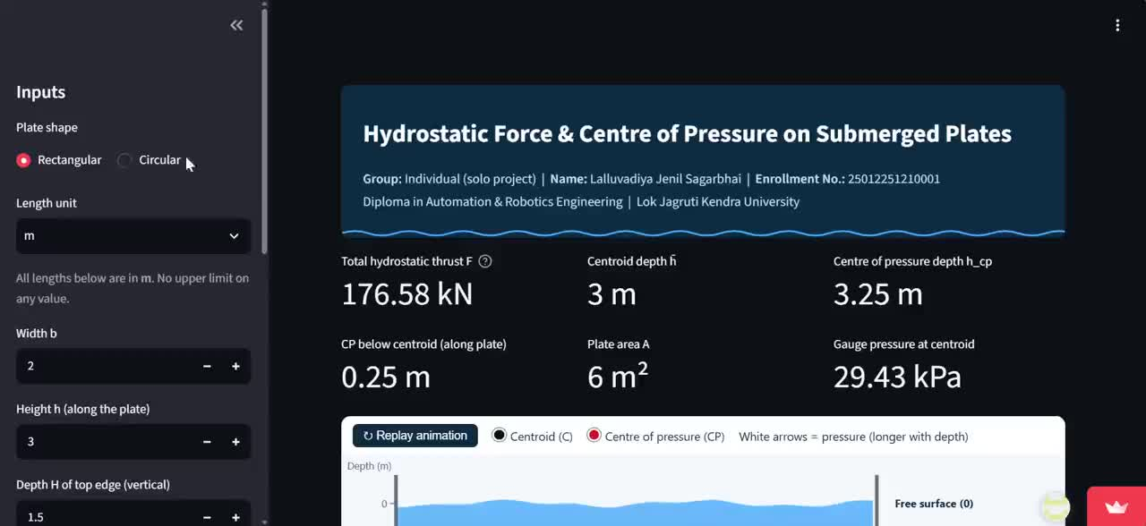
Live demo of the app

Slide 9
Submarine hatch example
Inputs
789.7 kN
  Liquid: sea water (1025 kg/m³)
  Plate: circular hatch, vertical
  Radius R = 0.5 m
  Depth of centre H = 100 m
  Length unit: m
Total thrust F, about 80 tonnes of force
1005.5 kPa
Pressure at the centroid, about 1 MPa
0.625 mm
CP below centroid, so h_cp = 100.0006 m

Slide 10
My role and workflow
Solo project
Lalluvadiya Jenil Sagarbhai did all the work: problem analysis, formulas, coding, animation, testing, GitHub upload, deployment, report and presentation.
1
2
3
4
Solve on paper
Build the app
Push to GitHub
Deploy live
Textbook numerical gives test values
app.py in Python and Streamlit
app.py and requirements.txt
Streamlit Community Cloud link

Slide 11
Conclusions and learnings
Engineering conclusions
What I learned
  Thrust grows with centroid depth and plate area.
  The center of pressure is always below the centroid, and the gap shrinks as the plate goes deeper.
  Tilting the plate cuts the vertical gap by sin²θ.
  Mercury gives about 13.6 times the thrust of water.
  Turning a textbook numerical into reusable code with Streamlit widgets.
  Checking the app against a manual solution to catch mistakes.
  Adding validation so impossible inputs give clear messages.
  Publishing an app through GitHub and Streamlit Community Cloud.

Slide 12


